Slide 1
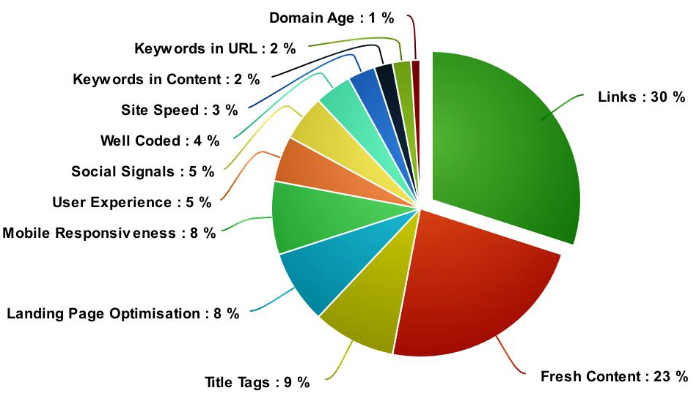
Notes:
OpenUmbrella.org

Slide 2
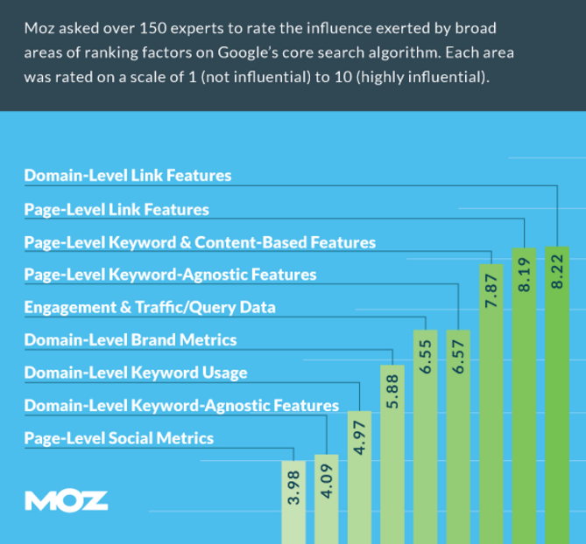

Slide 3
Keyword Research
Use Google Search
Research Your Competition
Google Keyword Planner
Paid Keyword Research Tools
Use Data From Google Analytics

Slide 4
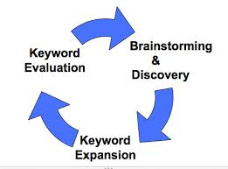
Keyword Research Process
Keep an open mind. Start with seed words and then allow the process to present your best options.
Notes:
Keep an open mind. Start with seed words and then allow the process to present your best options.

Slide 5
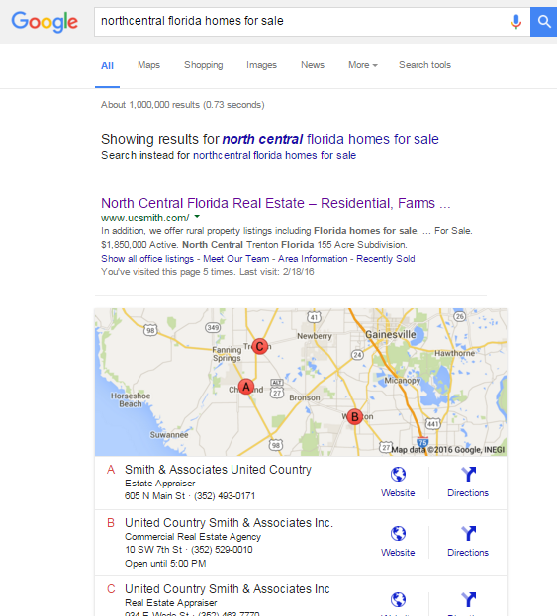
Search Results
Tip #1:
Search the Term or Phrase & Pay Attention to Auto-Correct

Slide 6
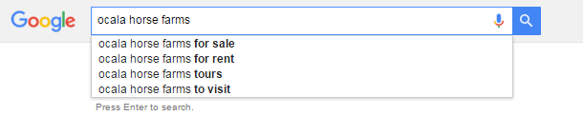
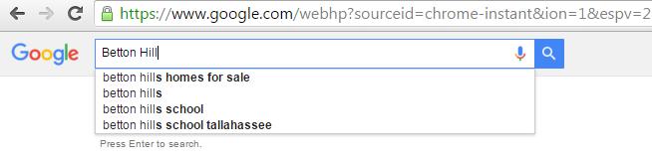
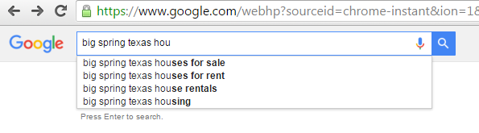
Tip #2: Google is telling you the most popular searches. Search your terms or phrase and pay attention to automated suggestions that populate…

Slide 7
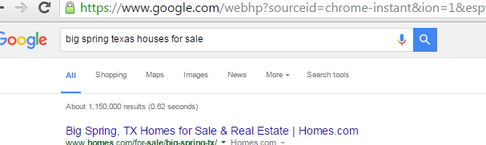
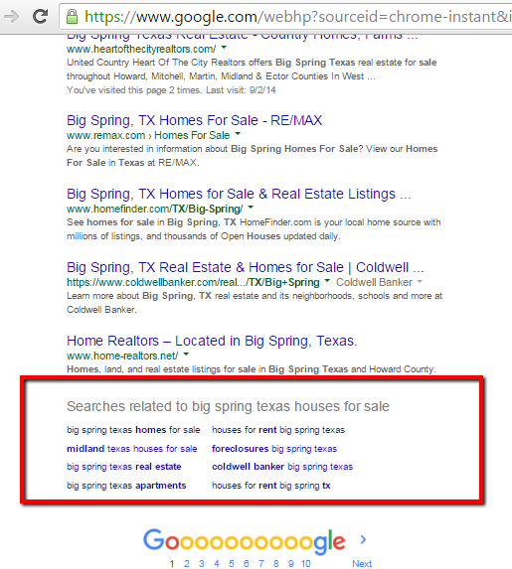
Related Searches
Tip #3
Great way to get ideas on keywords & phrases to consider for SEO
Search Term & Scroll to very bottom of the page to see related searches

Slide 8
Research your Competitors
Think of the terms related to your overall SEO strategy
Search Google for terms you wish to rank for and review the websites presently ranking.
“peanut farm for sale georgia”
Notes:
south georgia hunting land for sale
peanut farm for sale georgia

Slide 9
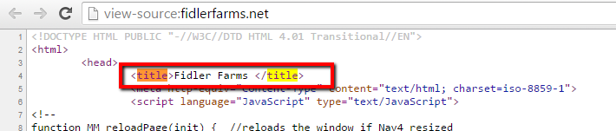
View Source
Right Click on Website
Choose View Source
CTRL + F (Find) - Title

Slide 10
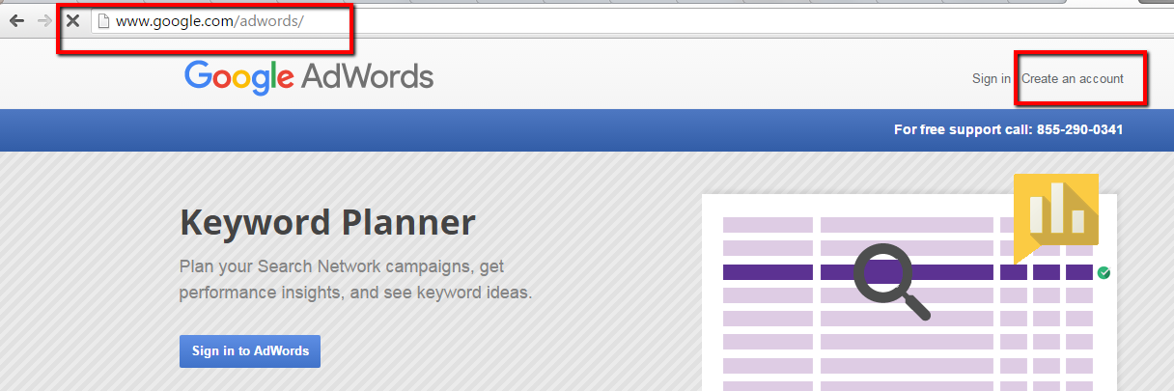
Google Keyword Planner
Designed for Google Adwords but Free
Requires a Google Account
Create a FREE AdWords Account

Slide 11
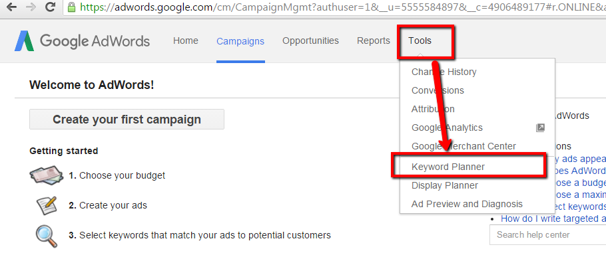
Google Keyword Planner

Slide 12
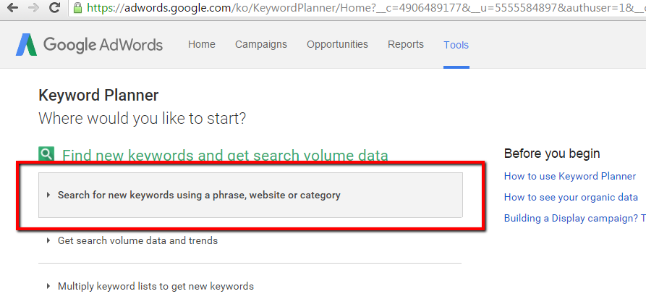
Search for Keywords

Slide 13
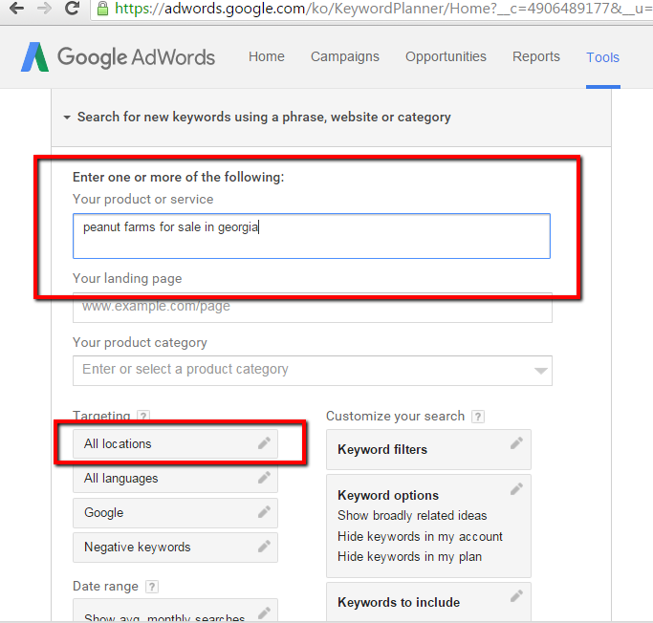

Slide 14
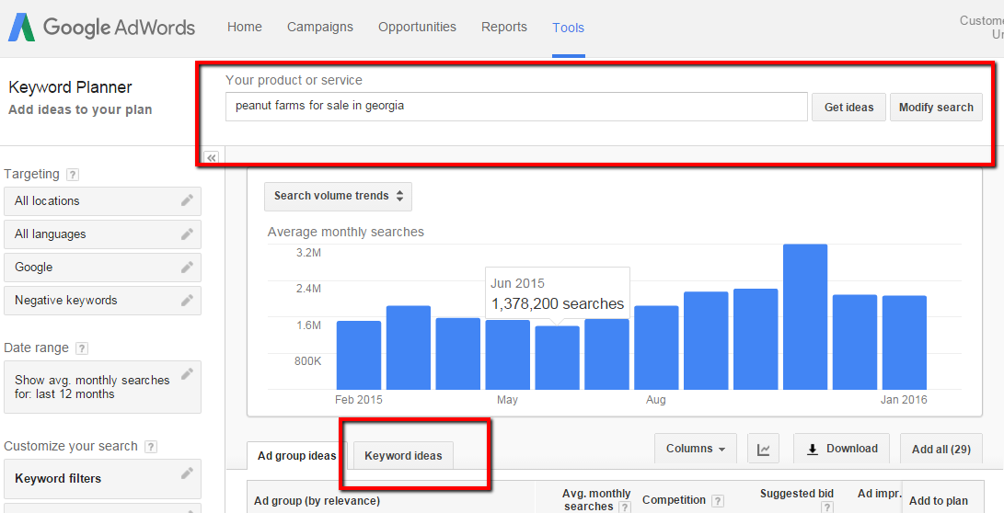
Get Keyword Ideas

Slide 15
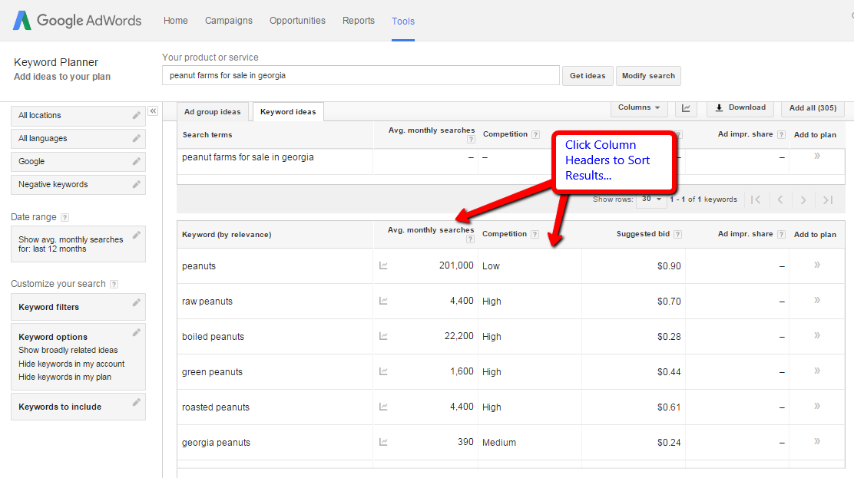
Mining Your Results

Slide 16
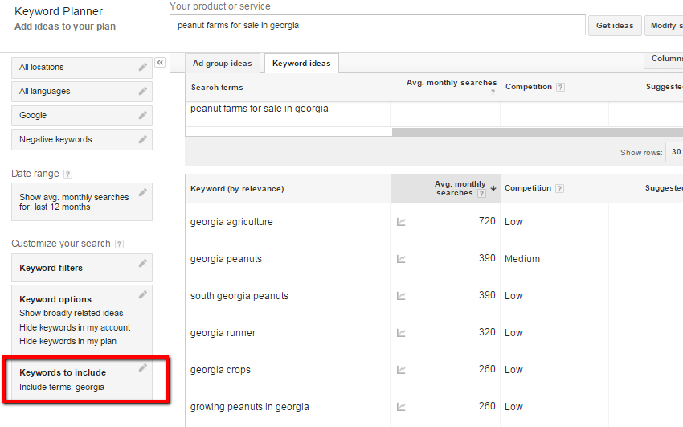
Tweak & Modify Search

Slide 17
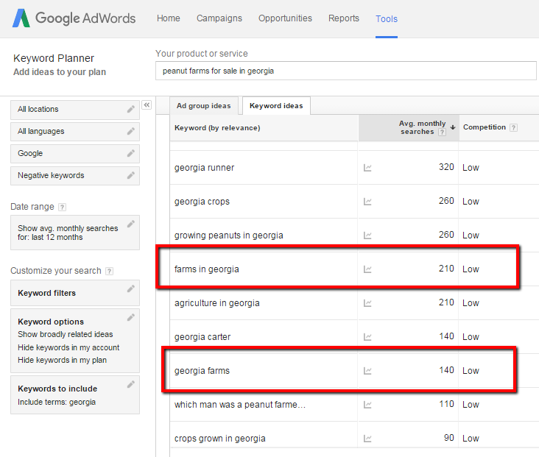

Slide 18
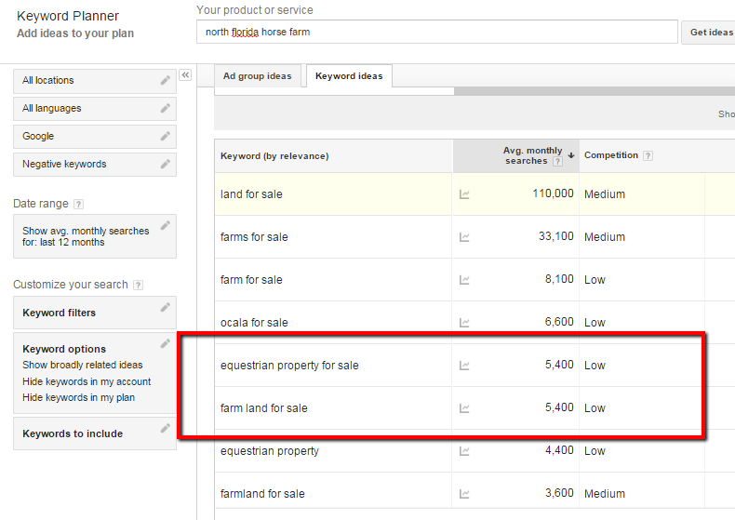
Another Sample Search Term

Slide 19
Never Stop Your SEO Efforts
Most Important Marketing You Can Do (and FREE)
"One thing I've seen consistently in my 15 years of experience is the belief that SEO is a one-time thing.
In reality, it is a process that never stops.
The moment you stop improving your site and search rankings is the moment you fall behind. Once you fall behind, it's incredibly difficult to catch up, and catching up is not easy to fix. Businesses that are serious about search and SEO must realize that it is a long-term investment.”
Rich Missey, North American SEO manager for Newarkelement14.

